Slide 1
TCP/IP Protocol Suite

Slide 2
TCP/IP Protocol Suite
It is a protocol suite - a set of protocols organized in different layers
Used in Internet today.
Five-layer model.
It is a hierarchical protocol made up of interactive modules.
Each module provides a specific functionality.
Hierarchical means - each upper level protocol is supported by the services
provided by one or more lower level protocols.

Slide 3
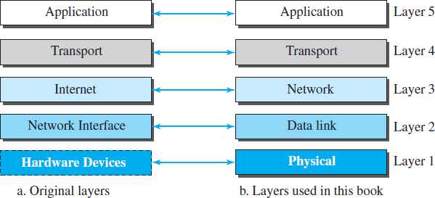
Layers in the TCP/IP protocol suite
Original TCP/IP protocol suite was defined as four software layers built upon the
hardware.

Slide 4
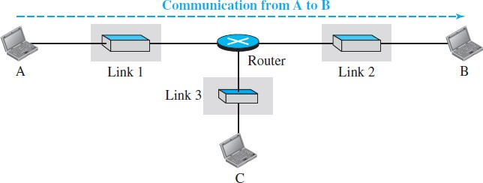
Communication through an internet
Small internet made up of three LANs (links), each with a link-layer switch.
Links are connected by one router.
Five communicating devices in this communication:
Source host (computer A)
Link-layer switch in link 1
Router
Link-layer switch in link 2
Destination host (computer B).

Slide 5
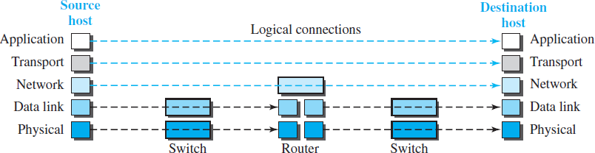
Logical connections between layers
Each device is involved with a set of layers depending on the role of the device in
the internet.
Two hosts are involved in all five layers.
Router is involved in only three layers.
A link-layer switch is involved only in two layers, data-link and physical.

Slide 6
Logical connections between layers cont..
Top three layers - application, transport, and network
Duty is end-to-end.
Domain of duty is the internet.
Data unit (packets) should not be changed by any router or link-layer switch.
Bottom two layers - data-link and physical
Duty is hop-to-hop, in which a hop is a host or router.
Domain of duty is the link.
Packet created by the host is changed only by routers, not by link-layer
switches.

Slide 7
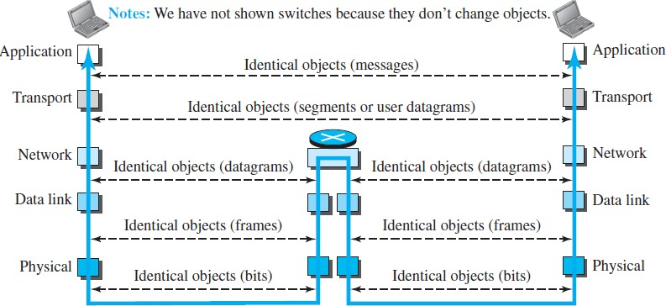
Identical objects in the TCP/IP protocol suite

Slide 8
Physical Layer
Responsible for carrying individual bits in a frame across the link.
Two devices are connected by a transmission medium (cable or air).
Medium does not carry bits.
Medium carries electrical or optical signals.
Bits received in a frame from DLL are transformed and sent through transmission media.
Several protocols that transform a bit to a signal.

Slide 9
Data-link Layer
It takes a datagram and encapsulates it in a packet called a frame.
When next link to travel is determined by router, DLL is responsible for taking datagram and moving it across link.
Link can be a
Wired LAN with a link-layer switch
Wireless LAN
Wired WAN
Wireless WAN
We can also have different protocols used with any link type.

Slide 10
Data-link Layer cont..
TCP/IP does not define any specific protocol for DLL.
It supports all standard and proprietary protocols.
Any protocol that can take the datagram and carry it through the link.
Each link-layer protocol may provide a different service.
Some link-layer protocols provide complete error detection and correction.
Some protocols provide only error correction.

Slide 11
Network Layer
Responsible for creating a connection between source and destination.
Responsible for host-to-host communication.
Routers are responsible for choosing best route for each packet.
Why we need network layer?
Separation of different tasks between different layers.
Routers do not need application and transport layers.

Slide 12
Network Layer: Internet Protocol (IP)
In the Internet, network layer includes the main protocol, IP.
Defines - format of the packet, called a datagram.
Defines - format and structure of addresses used in this layer.
Responsible for routing a packet from source to destination.
Each router forwarding the datagram to next router in its path.
Connectionless protocol.
No flow control, no error control, and no congestion control services.

Slide 13
Network Layer: Routing protocol
Layer includes
Unicast (one-to-one) routing protocol
Multicast (one-to-many) routing protocol
It does not take part in routing (it is the responsibility of IP).
It creates forwarding tables for routers to help them in the routing process.

Slide 14
Network Layer: Some auxiliary protocols
Help IP in its delivery and routing tasks.
Internet Control Message Protocol (ICMP)
Report some problems when routing a packet.
Internet Group Management Protocol (IGMP)
Multitasking.
Dynamic Host Configuration Protocol (DHCP)
Get network-layer address for a host.
Address Resolution Protocol (ARP)
Find link-layer address of a host or a router when its network-layer address is given.

Slide 15
Transport Layer
Logical connection is end-to-end.
At source, it gets message from application layer, encapsulates it in a transport layer packet (called a segment or a user datagram in different protocols) and sends it, through logical (imaginary) connection, to transport layer at destination.
It is responsible for giving services to application layer
Get a message from an application program running on source and deliver it to corresponding application program on destination.
It should be independent of application layer.
There are a few transport-layer protocols in the Internet.
Each designed for some specific task.

Slide 16
Transport Layer: Transmission Control Protocol (TCP)
Connection-oriented protocol.
It first establishes a logical connection between transport layers at two hosts before
transferring data.
It creates a logical pipe between two TCPs for transferring a stream of bytes.
Flow control
Match sending data rate of source with receiving data rate of destination to prevent
overwhelming the destination.
Error control
Guarantee that segments arrive at destination without error and resending corrupted
ones.
Congestion control
Reduce loss of segments due to congestion in network.

Slide 17
Transport Layer: User Datagram Protocol (UDP)
Connectionless protocol.
It transmits user datagrams without first creating a logical connection.
Each user datagram is an independent entity.
Simple protocol that does not provide flow, error, or congestion control.
It is attractive to an application program that needs to send short messages and cannot afford retransmission.
Stream Control Transmission Protocol (SCTP)
A new protocol.
It is designed to respond to new applications that are emerging in multimedia.

Slide 18
Application Layer
Logical connection between two application layers is end-to-end.
Duty - Process-to-process communication.
Communication is between two processes (two programs running at this
layer).
In Internet it includes many predefined protocols.

Slide 19
Application Layer
Hypertext Transfer Protocol (HTTP)
Vehicle for access World Wide Web (WWW).
Simple Mail Transfer Protocol (SMTP)
Main protocol used in electronic mail (e-mail) service.
File Transfer Protocol (FTP)
Used for transferring files from one host to another.
Terminal Network (TELNET) and Secure Shell (SSH)
Used for accessing a site remotely.
Simple Network Management Protocol (SNMP)
Used by an administrator to manage Internet at global and local levels.
Domain Name System (DNS)
Used by other protocols to find the network-layer address of a computer.
Internet Group Management Protocol (IGMP)
Used to collect membership in a group.

Slide 20
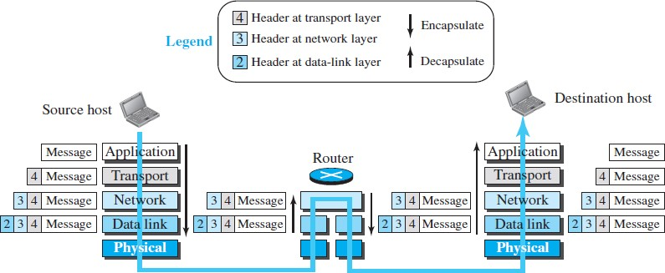
Encapsulation and Decapsulation
Encapsulation in source, decapsulation in destination, and encapsulation and decapsulation in router.
No encapsulation/ decapsulation occurs link-layer switches.

Slide 21
Encapsulation at the Source Host
Application layer
Data to be exchanged is referred to as a message.
Message does not contain any header or trailer.
Message is passed to transport layer.
Transport layer
Takes the message as payload.
It adds header to payload, which contains identifiers of source and destination
application programs.
It adds some more information that is needed for end-to-end delivery of message, such
as information needed for flow, error control, or congestion control.
Resulting transport-layer packet, which is called segment (in TCP) and user datagram
(in UDP).
It passes packet to network layer.

Slide 22
Encapsulation at the Source Host
Network layer
Takes transport-layer packet as data or payload.
Adds its own header to the payload.
Header contains addresses of source and destination hosts and some more information used for error checking of the header, fragmentation information, and so on.
Resulting network-layer packet, called a datagram.
It then passes packet to data-link layer.
Data-link layer
Takes network-layer packet as data or payload.
Adds its own header, which contains link-layer addresses of host or next hop (router).
Resulting link-layer packet, which is called a frame.
Frame is passed to physical layer.

Slide 23
Decapsulation and Encapsulation at the Router
Both decapsulation and encapsulation is performed at router because it is connected to
two or more links.
Set of bits are delivered to DLL. DLL decapsulates datagram from frame and passes it
to network layer.
Network layer only inspects source and destination addresses in datagram header and
consults its forwarding table to find the next hop.
Contents of datagram should not be changed by network layer in the router unless
there is a need to fragment the datagram if it is too big to be passed through the next
link.
Datagram is then passed to DLL of next link.
DLL of next link encapsulates the datagram in a frame and passes it to physical layer
for transmission.

Slide 24
Decapsulation at the Destination Host
At the destination host, each layer
Only decapsulates the packet received
Removes the payload
Delivers the payload to the next-higher layer protocol until the message reaches the application layer.
Decapsulation involves error checking.

Slide 25
OSI vs TCP/IP
OSI
TCP/IP
Application
User space
Presentation
Application
Session
Software
Transport
Transport
Operating System
Firmware
Network
Network
Hardware
Data Link
Data Link
Physical
Physical

Slide 26
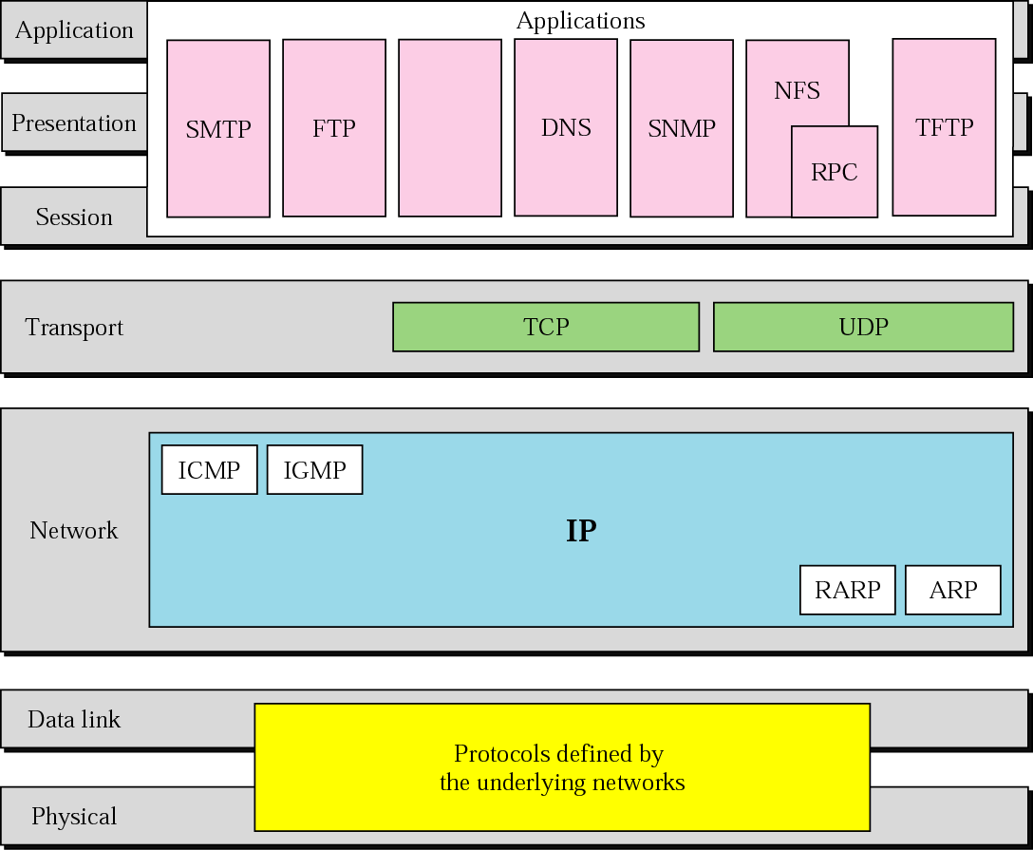
TCP/IP and OSI model

Slide 27
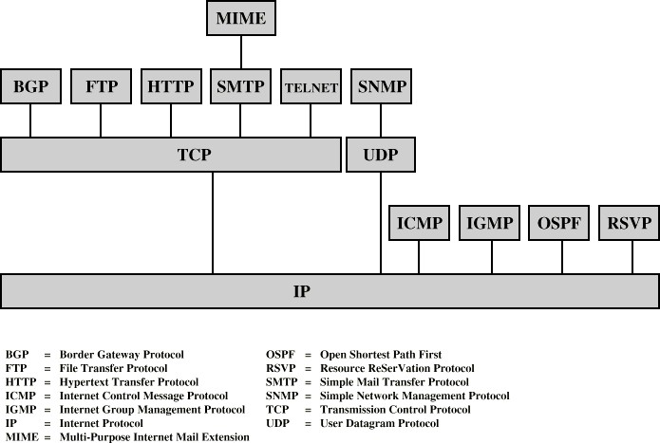
Protocol Stacks

Slide 28
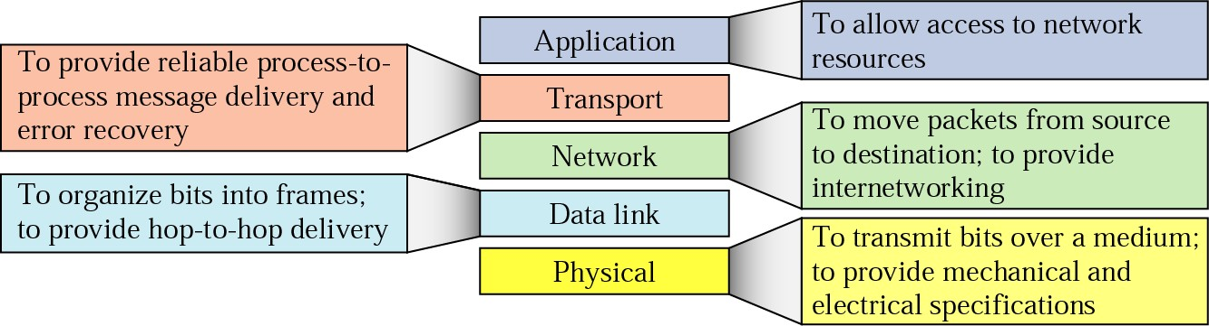
Summary of duties

Slide 29
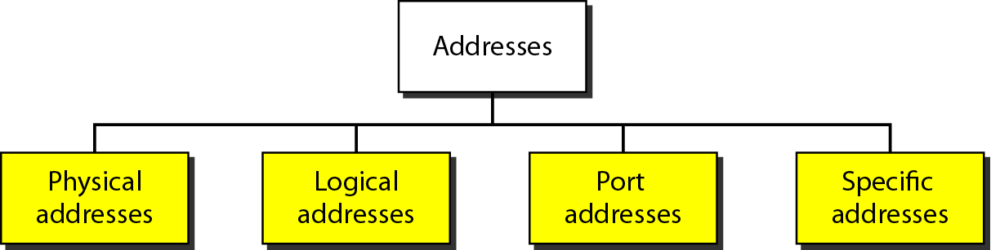
Figure 2.17 Addresses in TCP/IP

Slide 30
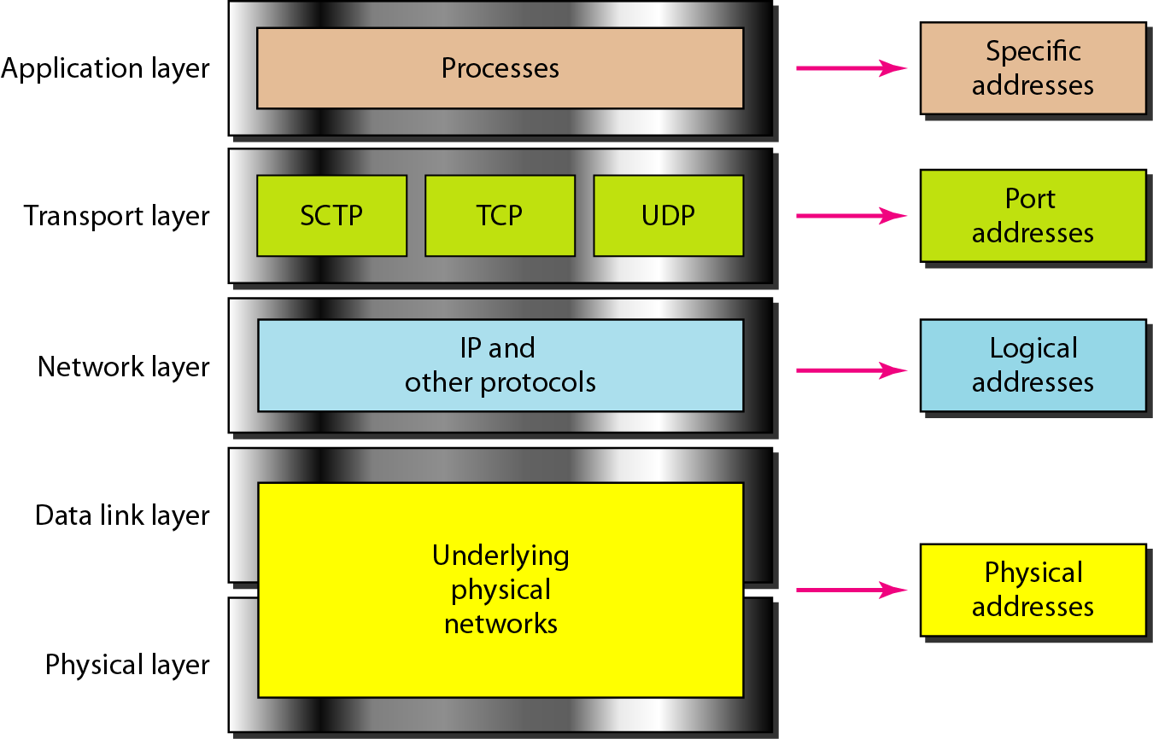
Figure 2.18 Relationship of layers and addresses in TCP/IP

Slide 31
Example 2.1
In Figure 2.19 a node with physical address 10 sends a frame to a node with physical address 87. The two nodes are connected by a link (bus topology LAN). As the figure shows, the computer with physical address 10 is the sender, and the computer with physical address 87 is the receiver.

Slide 32
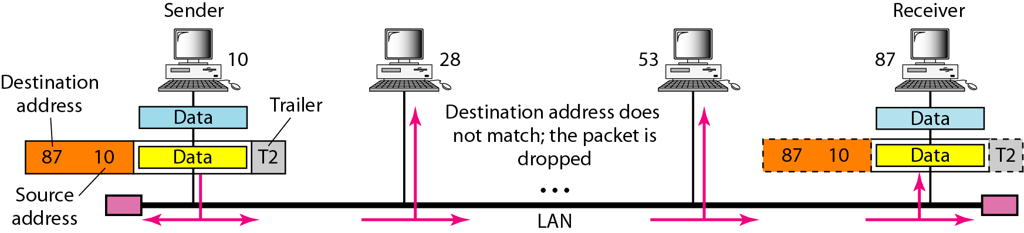
Figure 2.19 Physical addresses

Slide 33
Example 2.2
Most local-area networks use a 48-bit (6-byte) physical address written as 12 hexadecimal digits; every byte (2 hexadecimal digits) is separated by a colon, as shown below:
07:01:02:01:2C:4B
A 6-byte (12 hexadecimal digits) physical address.

Slide 34
Example 2.3
Figure 2.20 shows a part of an internet with two routers connecting three LANs. Each device (computer or router) has a pair of addresses (logical and physical) for each connection. In this case, each computer is connected to only one link and therefore has only one pair of addresses. Each router, however, is connected to three networks (only two are shown in the figure). So each router has three pairs of addresses, one for each connection.

Slide 35
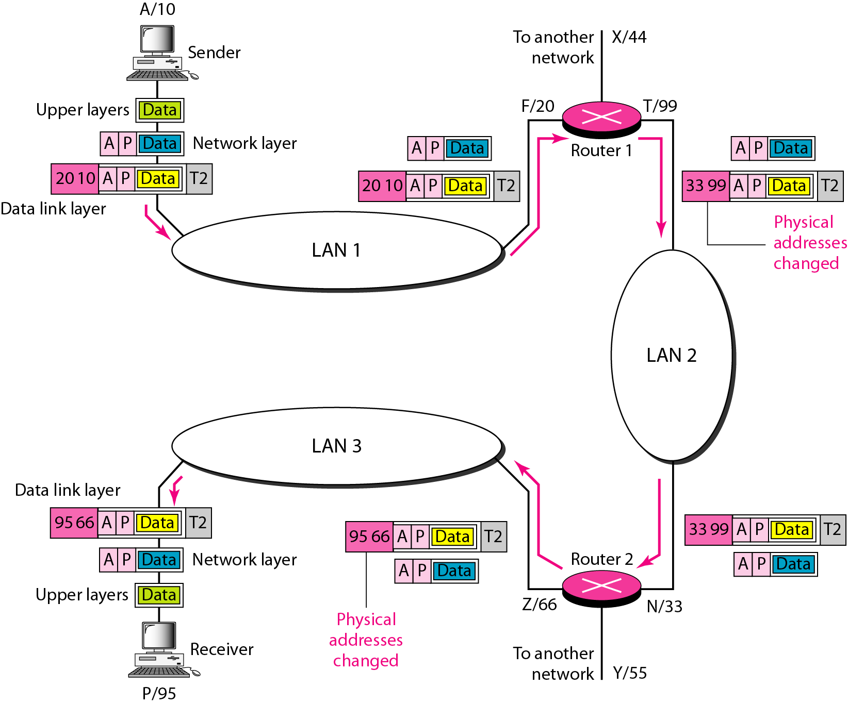
Figure 2.20 IP addresses

Slide 36
Example 2.4
Figure 2.21 shows two computers communicating via the Internet. The sending computer is running three processes at this time with port addresses a, b, and c. The receiving computer is running two processes at this time with port addresses j and k. Process a in the sending computer needs to communicate with process j in the receiving computer. Note that although physical addresses change from hop to hop, logical and port addresses remain the same from the source to destination.

Slide 37
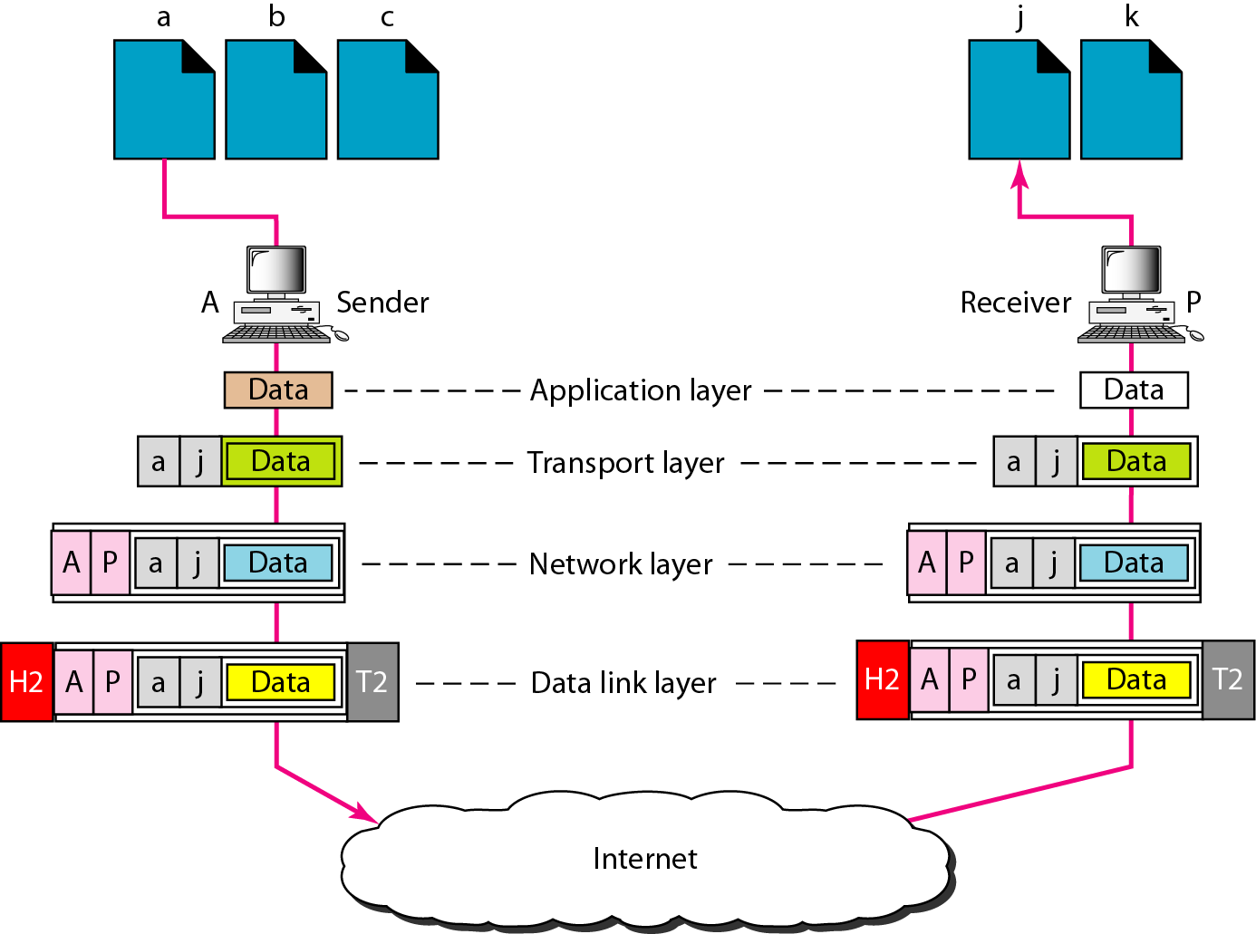
Figure 2.21 Port addresses

Slide 38

Note
The physical addresses will change from hop to hop,
but the logical addresses usually remain the same.

Slide 39
Example 2.5
A port address is a 16-bit address represented by one decimal number as shown.
753
A 16-bit port address represented as one single number.

